Slide 1
PDF Extractor
Mini-Project
PROJECT REPORT- I
(Python)
Submitted to:
Mr. Suhel Mustajab
Dr. Swaleha Zubair
Mr. Sunil Kumar Sharma
Mr. Naved Iqbal
Mr. Tipu Sultan
Submitted by:
ABDULLAH AHMAD KHAN
18MCA007
GH2830

Slide 2
CONTENTS
Introduction Purpose
Existing System
Functional Requirements
Non- Functional Requirements ER Diagram Relational Schema/ Data Dictionary
Use case Diagram
Model Used
System Requirement

Slide 3
What is PDF and PDF Extractor?
PDF stands for Portable Document Format. It uses .pdf extension.
PDF Extractor will help people to extract PDF file into simple text even the Snapshot of any hand written page can be extracted which may help in searching a keyword in plethora of pages.

Slide 4
Purpose of the New System
To be able to extract text from PDF files and images.
To make searching a keyword easier.
The burden of manual work is reduced because now we are able to use search even in the snapshot of any image in the PDF file.

Slide 5
Existing System
The existing system lack proper GUI (Graphical User Interface) and that system can only be executed by trained programmer or the person who have knowledge of programming , no other user can able to use the system.

Slide 6
Proposed System
It requires less overhead and is very efficient.
It also gives us a path to wherever we want to save to file which lacks in the previous system as well as the option to select the desired file.
The new proposed PDF EXTRACTOR system is created in such a manner that it can be used by anyone , even a person who have just a little knowledge of working of computer.

Slide 7
To be able to extract text from PDF files.
Functional requirement
To be able to extract text from image as well.
To make searching a keyword easier .
The system is user friendly and built in Window environment.

Slide 8
Non-Functional Requirements
Reliability
Performance
Operational Feasibility
Technical Feasibility
Economic Feasibility

Slide 9
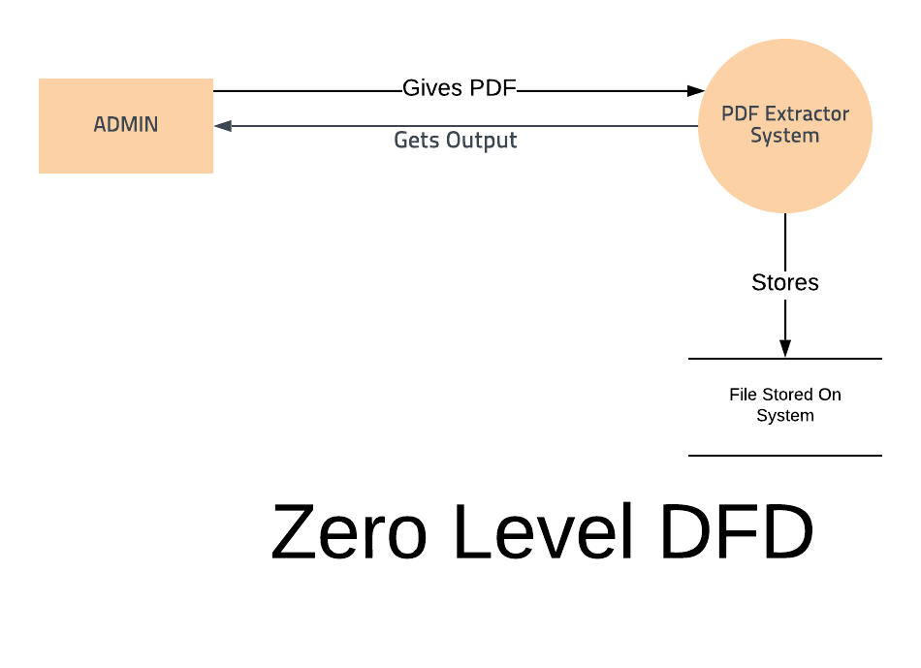
Data Flow Diagram:

Slide 10
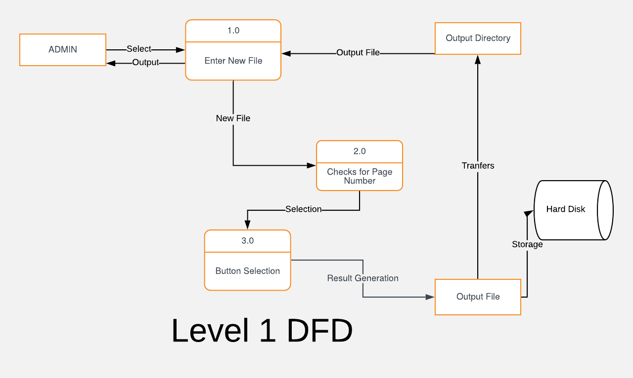

Slide 11
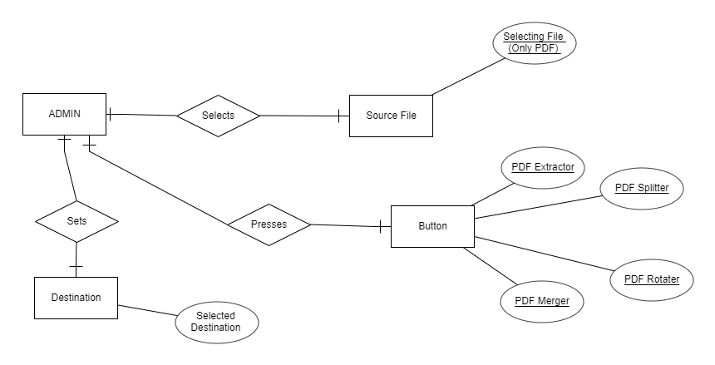
ER Diagram:

Slide 12
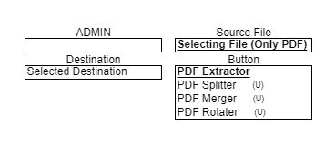
Relational Schema / Data Dictionary :

Slide 13
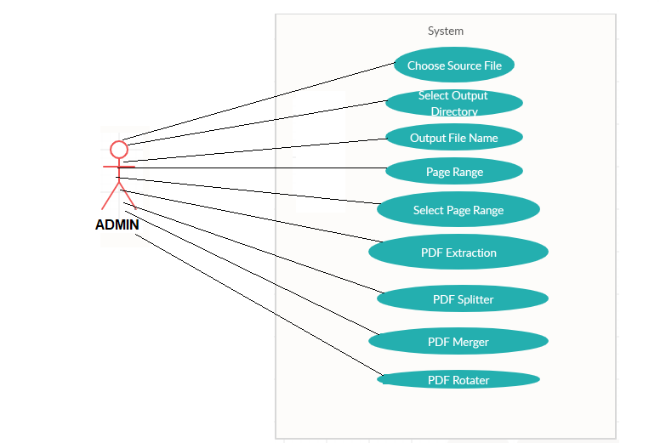
Use case Diagram:

Slide 14
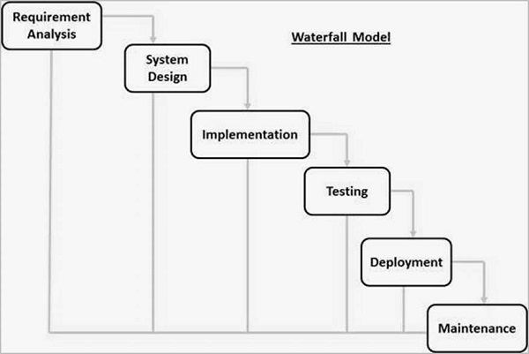
DRAFT MODEL:
As the Requirements are well understood. Waterfall model is simple and easy to understand and use.

Slide 15
Different Phases of Waterfall Model are:
Requirement Gathering and analysis − All possible requirements of the system to be developed are captured in this phase and documented in a requirement specification document.
System Design − The requirement specifications from first phase are studied in this phase and the system design is prepared. This system design helps in specifying hardware and system requirements and helps in defining the overall system architecture.
Implementation − With inputs from the system design, the system is first developed in small programs called units, which are integrated in the next phase. Each unit is developed and tested for its functionality, which is referred to as Unit Testing.
Integration and Testing − All the units developed in the implementation phase are integrated into a system after testing of each unit. Post integration the entire system is tested for any faults and failures.
Deployment of system − Once the functional and non-functional testing is done; the product is deployed in the customer environment or released into the market.
Maintenance − There are some issues which come up in the client environment. To fix those issues, patches are released. Also to enhance the product some better versions are released. Maintenance is done to deliver these changes in the customer environment.
Different Phases of Waterfall Model are:

Slide 16
Proposed Software Tools to be used
User Interface (Front end): Python 3.7.4
GUI(Graphical User Interface): Appjar 2.4
Software: PyCharm 19.2

Slide 17
THANKS

